Slide 1

DESIGN AND ANALYSIS OF ALGORITHMS (113939)
Dr. Owais Hussain

Slide 2

Agenda
Recap
How to write Recursive Algorithms
Sum of Numbers
Fibonacci Series
Binary Search
Complexity Analysis of Binary Search
Tower of Hanoi Problem

Slide 3
Sample 2
Recap
Recursion (also Recurrence) is one of the core concepts of algorithms. A wide range of problems are solved via recursion.
In your earlier courses, you must have covered a few examples of recursion including Factorial calculation and Binary search.
Let’s go through a series of small exercises to get a grip on this subject.

Slide 4
Sample 2
How to Write Recursive Algorithms
A recursive algorithm can be designed using the following simple steps:
Identify the base case, i.e., the simplest case to solve.
Identify the condition to terminate the function so that it does not go on indefinitely. (Otherwise, be ready for StackOverflowException)
Identify the recursive case which breaks the sub-problem into simplest case.
Collect the output from recursive case by combining the solutions to sub-problems.

Slide 5
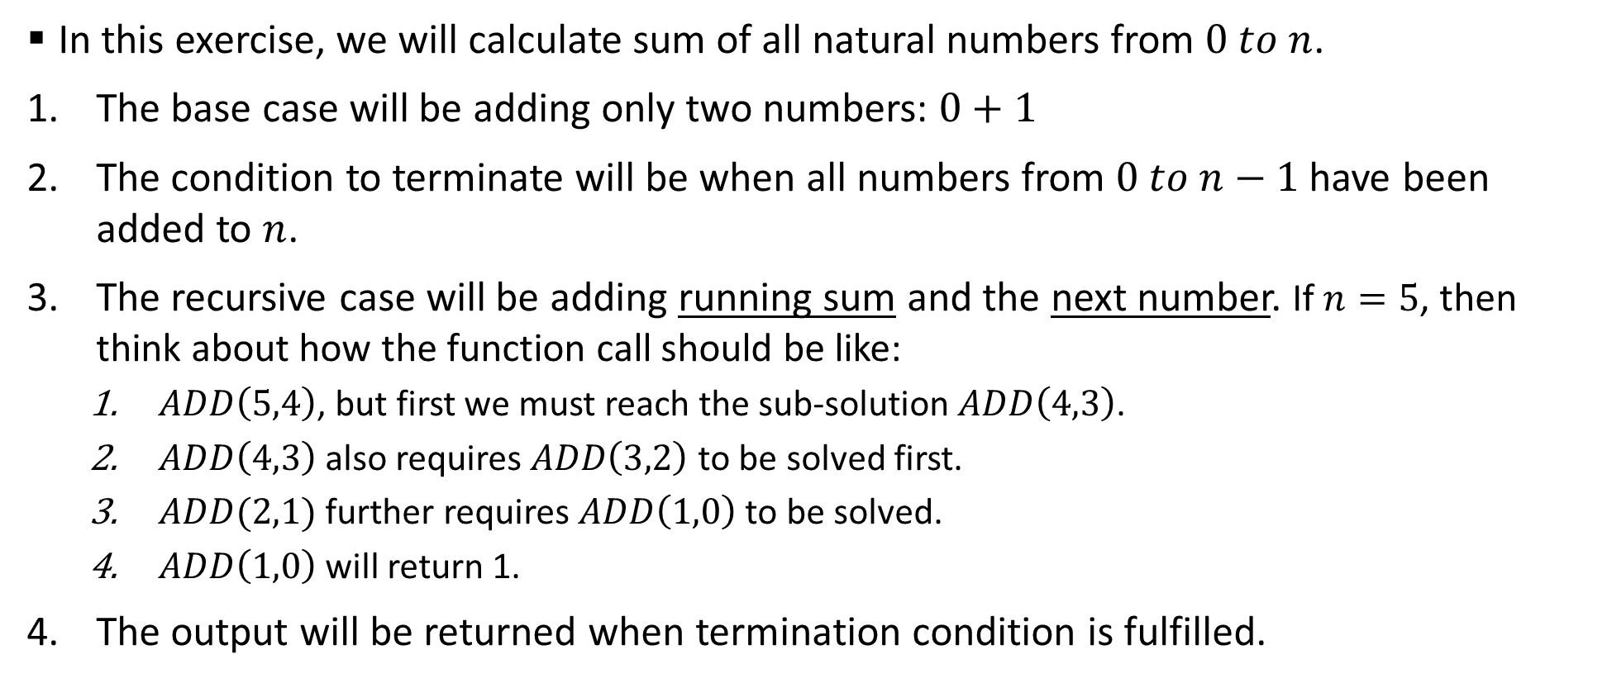
Sample 2
Sum of Numbers
In this exercise, we will calculate sum of all natural numbers from $0 to n$.
The base case will be adding only two numbers: $0+1$
The condition to terminate will be when all numbers from $0 to n−1$ have been added to $n$.
The recursive case will be adding running sum and the next number. If $n=5$, then think about how the function call should be like:
$ADD\left(5,4\right)$, but first we must reach the sub-solution $ADD\left(4,3\right)$.
$ADD\left(4,3\right)$ also requires $ADD\left(3,2\right)$ to be solved first.
$ADD(2,1)$ further requires $ADD\left(1,0\right)$ to be solved.
$ADD\left(1,0\right)$ will return 1.
The output will be returned when termination condition is fulfilled.

Slide 6
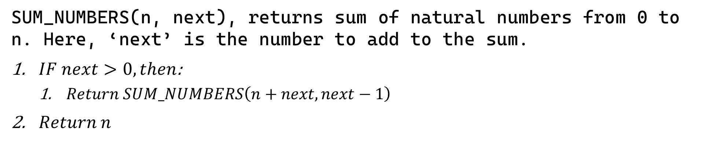
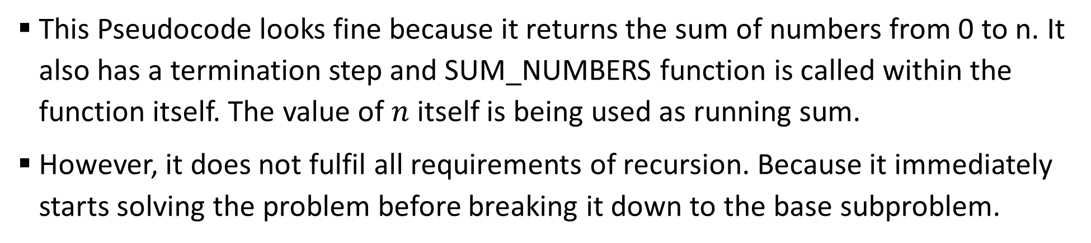
Sample 2
Sum of Numbers
SUM_NUMBERS(n, next), returns sum of natural numbers from 0 to n. Here, ‘next’ is the number to add to the sum.
$IF next>0, then$:
$Return SUM_NUMBERS\left(n+next, next−1\right)$
$Return n$
This Pseudocode looks fine because it returns the sum of numbers from 0 to n. It also has a termination step and SUM_NUMBERS function is called within the function itself. The value of $n$ itself is being used as running sum.
However, it does not fulfil all requirements of recursion. Because it immediately starts solving the problem before breaking it down to the base subproblem.

Slide 7
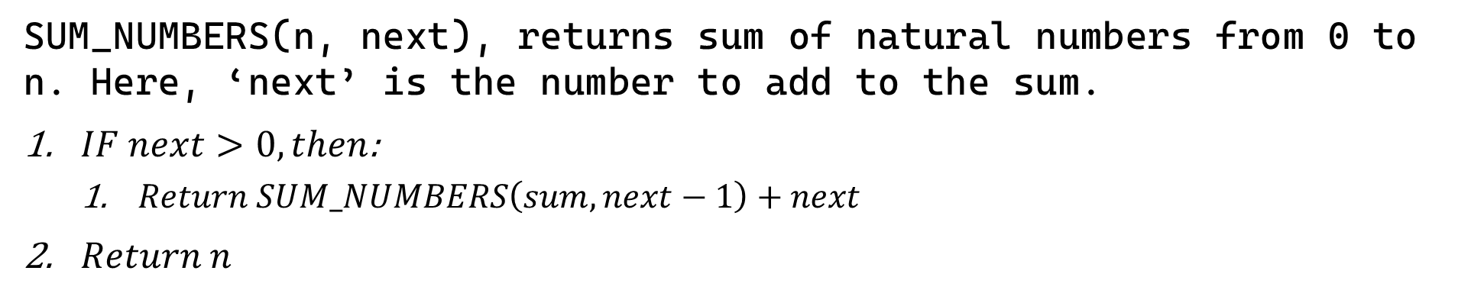
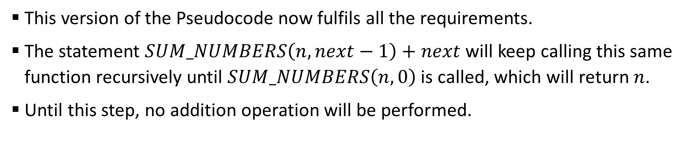
Sample 2
Sum of Numbers
SUM_NUMBERS(n, next), returns sum of natural numbers from 0 to n. Here, ‘next’ is the number to add to the sum.
$IF next>0, then$:
$Return SUM_NUMBERS\left(sum, next−1\right)+next$
$Return n$
This version of the Pseudocode now fulfils all the requirements.
The statement $SUM_NUMBERS\left(n, next−1\right)+next$ will keep calling this same function recursively until $SUM_NUMBERS\left(n,0\right)$ is called, which will return $n$.
Until this step, no addition operation will be performed.

Slide 8
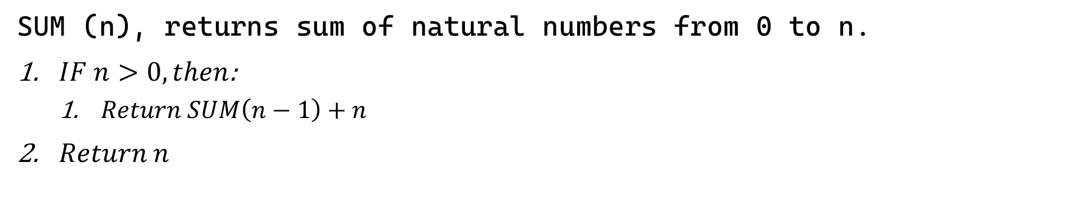
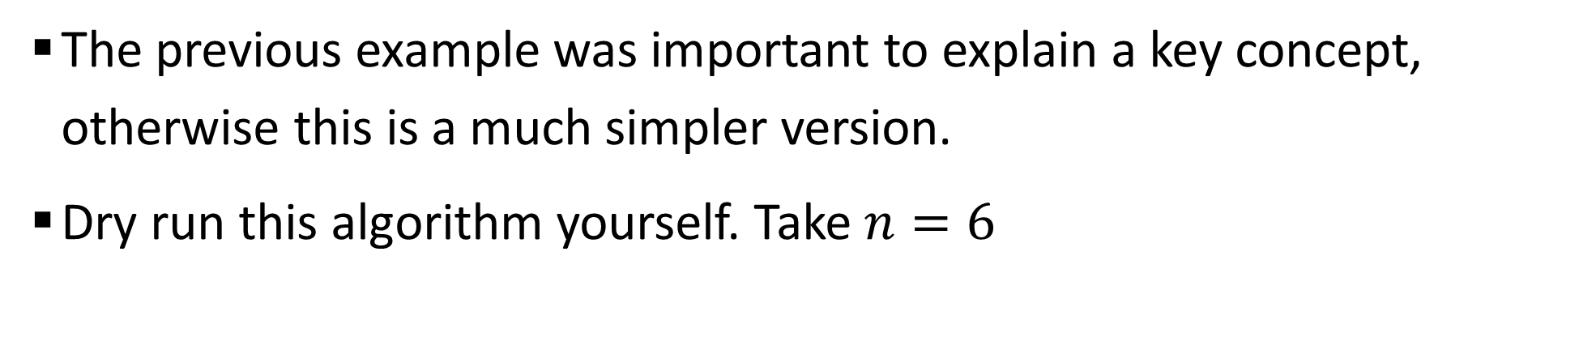
Sample 2
Sum of Numbers - Simplified
SUM (n), returns sum of natural numbers from 0 to n.
$IF n>0, then$:
$Return SUM\left(n−1\right)+n$
$Return n$
The previous example was important to explain a key concept, otherwise this is a much simpler version.
Dry run this algorithm yourself. Take $n=6$

Slide 9
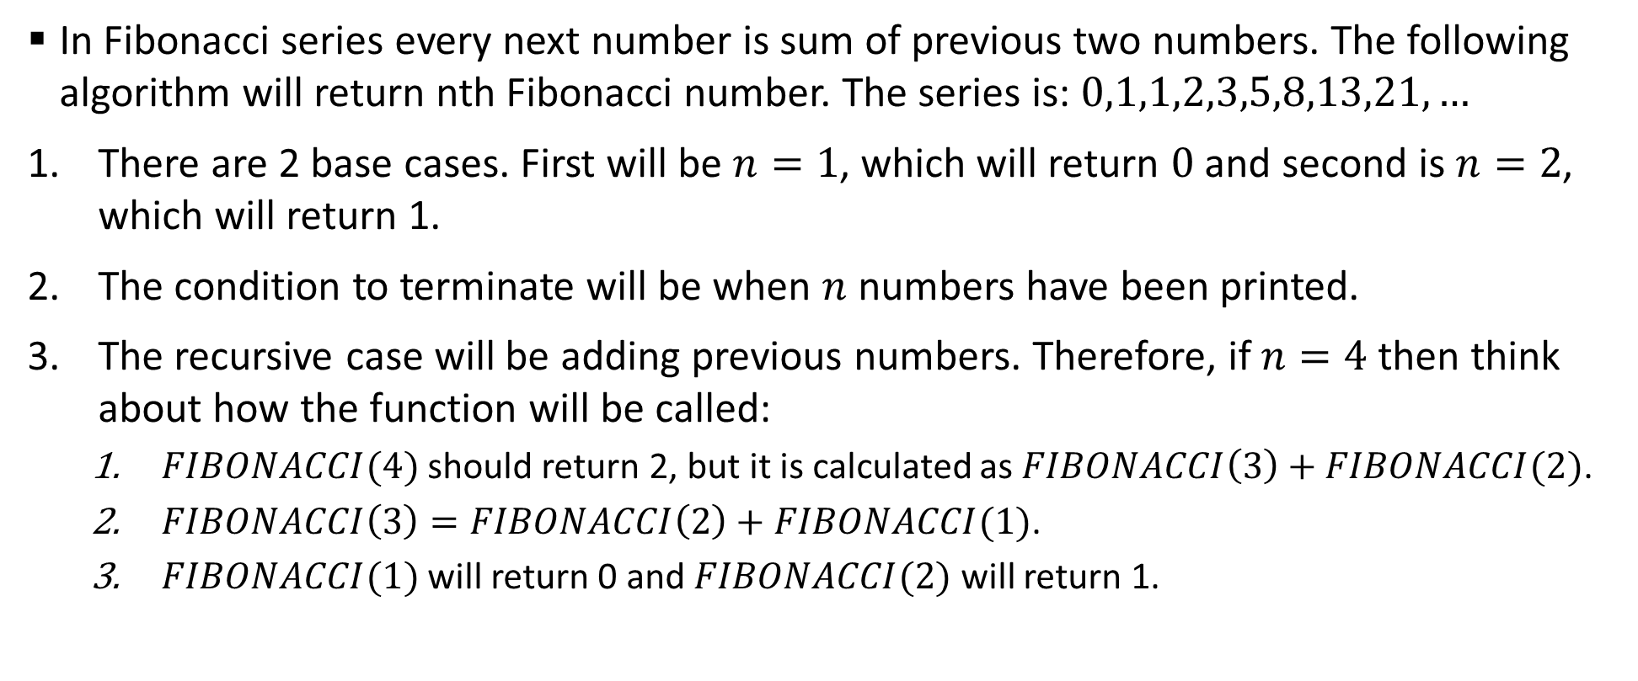
Sample 2
Fibonacci Series
In Fibonacci series every next number is sum of previous two numbers. The following algorithm will return nth Fibonacci number. The series is: $0,1,1,2,3,5,8,13,21,…$
There are 2 base cases. First will be $n=1$, which will return $0$ and second is $n=2$, which will return 1.
The condition to terminate will be when $n$ numbers have been printed.
The recursive case will be adding previous numbers. Therefore, if $n=4$ then think about how the function will be called:
$FIBONACCI(4)$ should return 2, but it is calculated as $FIBONACCI\left(3\right)+FIBONACCI(2)$.
$FIBONACCI\left(3\right)=FIBONACCI\left(2\right)+FIBONACCI(1)$.
$FIBONACCI(1)$ will return 0 and $FIBONACCI(2)$ will return 1.

Slide 10
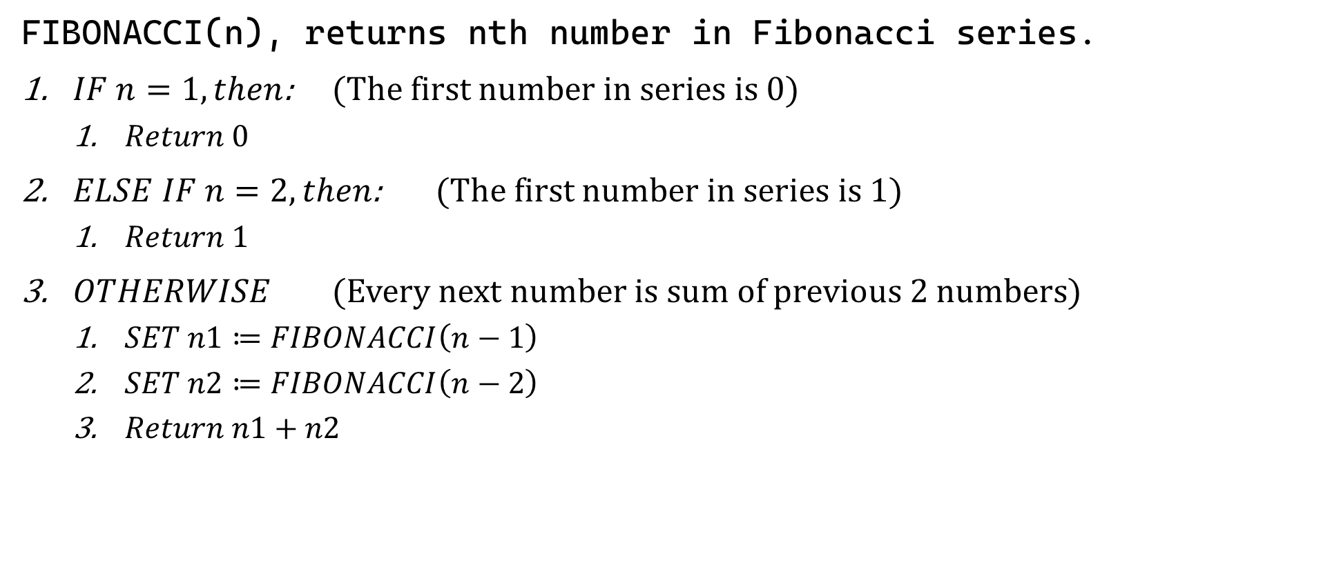
Sample 2
Fibonacci Series
FIBONACCI(n), returns nth number in Fibonacci series.
$IF n=1, then$: (The first number in series is 0)
$Return 0$
$ELSE IF n=2, then$: (The first number in series is 1)
$Return 1$
$OTHERWISE$ (Every next number is sum of previous 2 numbers)
$SET n1≔FIBONACCI\left(n−1\right)$
$SET n2≔FIBONACCI\left(n−2\right)$
$Return n1+n2$

Slide 11
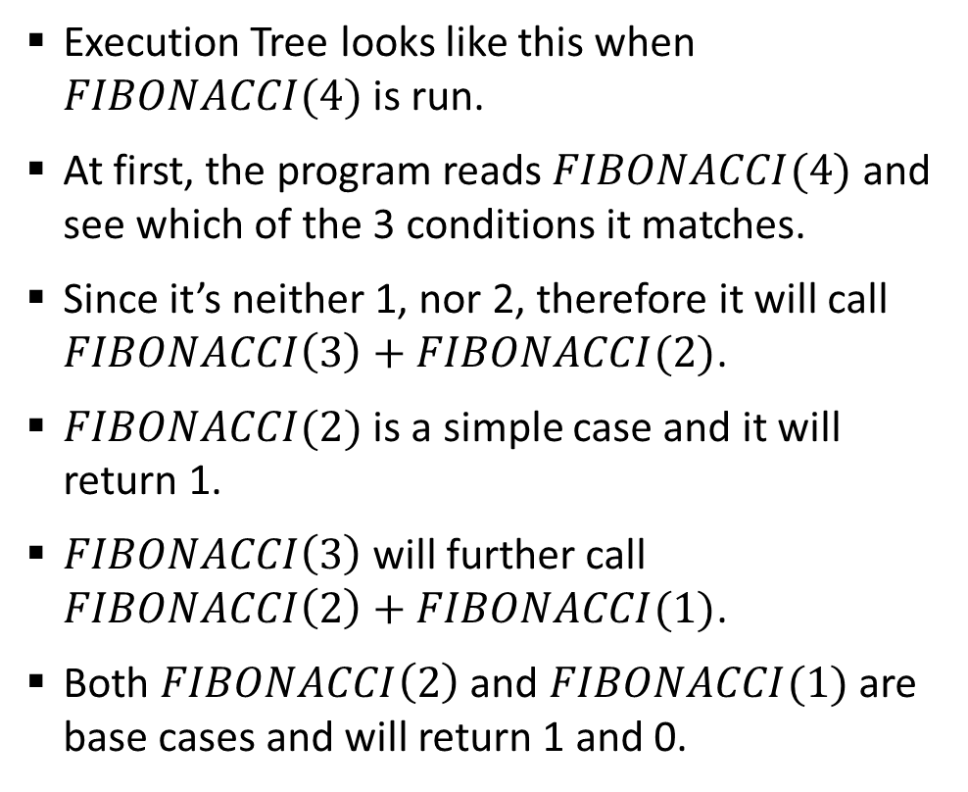
Sample 2
Fibonacci Series
Execution Tree looks like this when $FIBONACCI(4)$ is run.
At first, the program reads $FIBONACCI(4)$ and see which of the 3 conditions it matches.
Since it’s neither 1, nor 2, therefore it will call $FIBONACCI\left(3\right)+FIBONACCI(2)$.
$FIBONACCI(2)$ is a simple case and it will return 1.
$FIBONACCI\left(3\right)$ will further call $FIBONACCI\left(2\right)+FIBONACCI(1)$.
Both $FIBONACCI\left(2\right)$ and $FIBONACCI(1)$ are base cases and will return 1 and 0.
Fib(4)
Fib(3)
Fib(2)
Fib(2)
Fib(1)
1
0
1

Slide 12
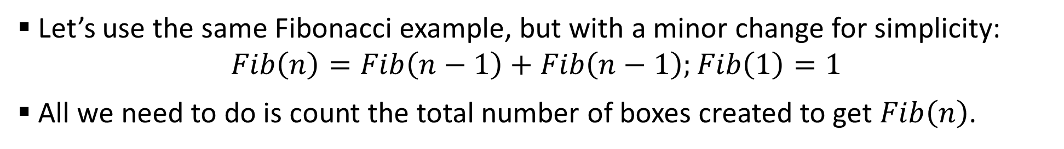
Sample 2
Fibonacci Series
Let’s use the same Fibonacci example, but with a minor change for simplicity: $Fib\left(n\right)=Fib\left(n−1\right)+Fib\left(n−1\right);Fib\left(1\right)=1$
All we need to do is count the total number of boxes created to get $Fib\left(n\right)$.
Fib(3)
Fib(2)
Fib(1)
Fib(2)
Fib(1)
Fib(4)
Fib(3)
Fib(2)
Fib(2)
Fib(1)
Fib(1)
Fib(1)
Fib(1)
Fib(1)
Fib(1)
1
1
1
1
1
1
1
1
Notes:
Explain in detail why this so-called simplicity was needed

Slide 13
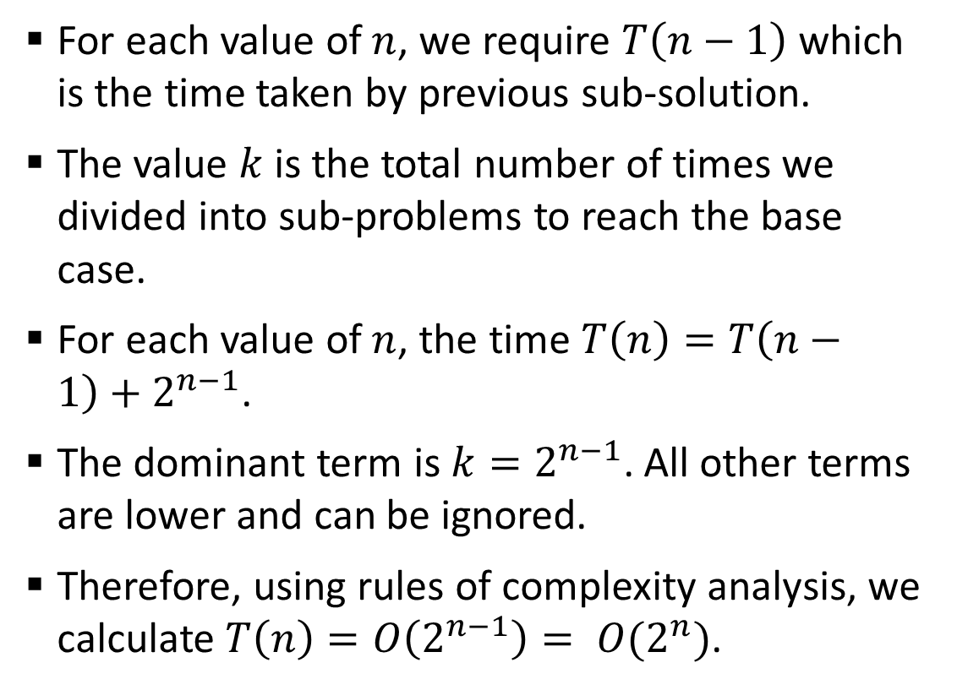
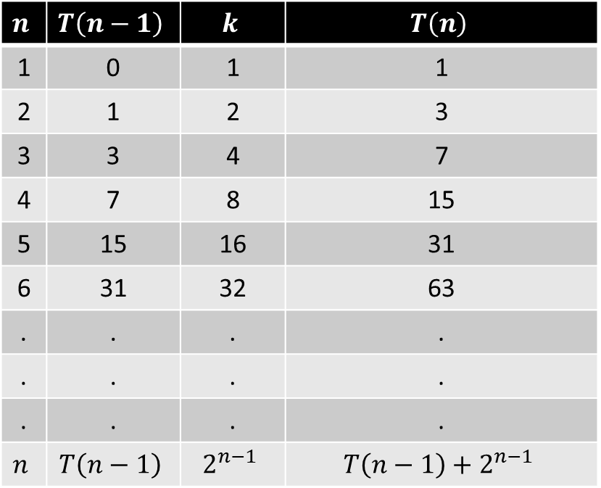
Sample 2
Fibonacci Series
For each value of $n$, we require $T\left(n−1\right)$ which is the time taken by previous sub-solution.
The value $k$ is the total number of times we divided into sub-problems to reach the base case.
For each value of $n$, the time $T\left(n\right)=T\left(n−1\right)+2^{n−1}$.
The dominant term is $k=2^{n−1}$. All other terms are lower and can be ignored.
Therefore, using rules of complexity analysis, we calculate $T\left(n\right)=O\left(2^{n−1}\right)= O(2^{n})$.
$$n$$ | $$T\left(n−1\right)$$ | $$k$$ | $$T\left(n\right)$$
1 | 0 | 1 | 1
2 | 1 | 2 | 3
3 | 3 | 4 | 7
4 | 7 | 8 | 15
5 | 15 | 16 | 31
6 | 31 | 32 | 63
. | . | . | .
. | . | . | .
. | . | . | .
$$n$$ | $$T\left(n−1\right)$$ | $$2^{n−1}$$ | $$T\left(n−1\right)+2^{n−1}$$

Slide 14
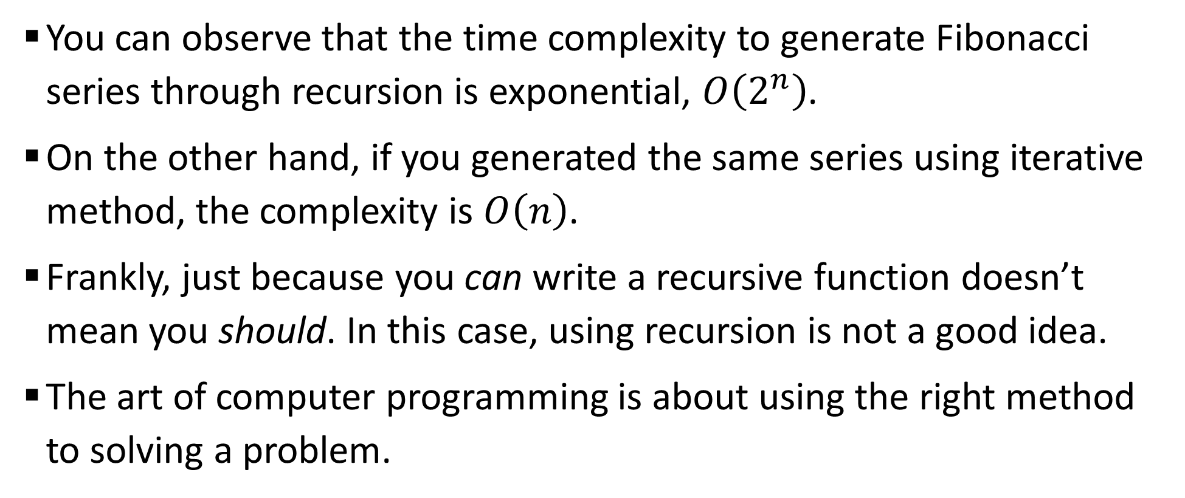
Sample 2
Fibonacci Series
You can observe that the time complexity to generate Fibonacci series through recursion is exponential, $O\left(2^{n}\right)$.
On the other hand, if you generated the same series using iterative method, the complexity is $O\left(n\right)$.
Frankly, just because you can write a recursive function doesn’t mean you should. In this case, using recursion is not a good idea.
The art of computer programming is about using the right method to solving a problem.

Slide 15
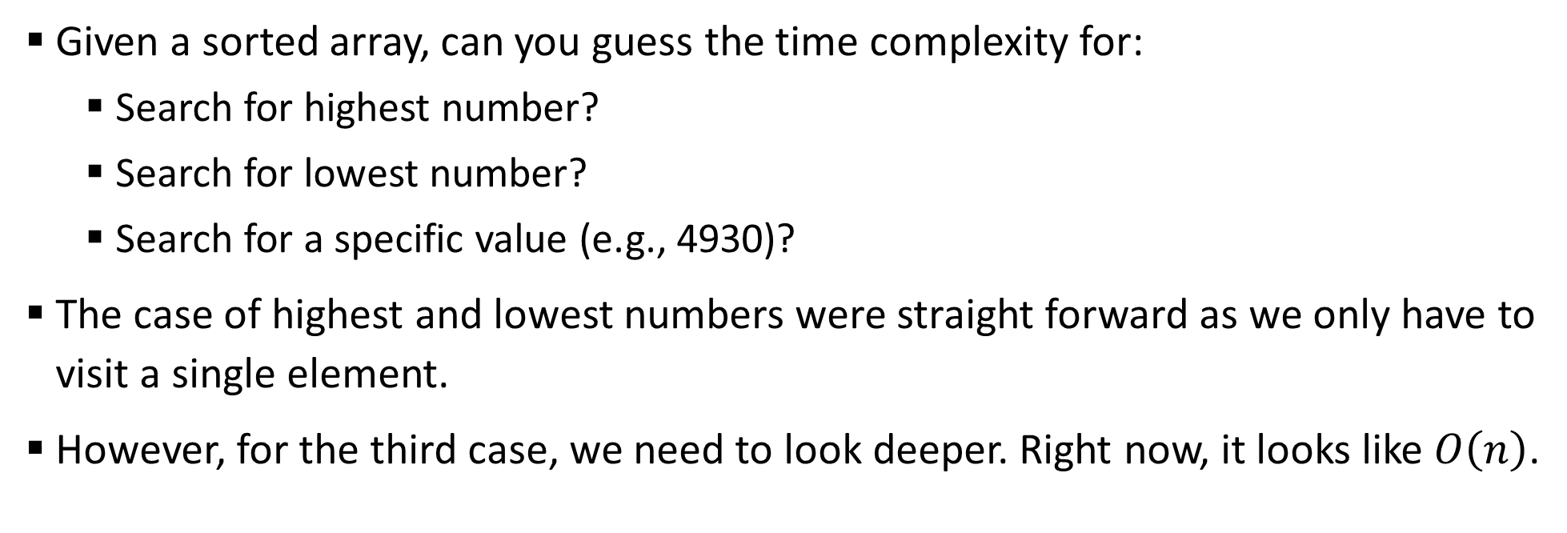
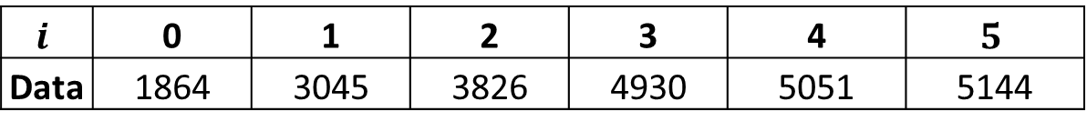
Sample 2
Binary Search
Given a sorted array, can you guess the time complexity for:
Search for highest number?
Search for lowest number?
Search for a specific value (e.g., 4930)?
The case of highest and lowest numbers were straight forward as we only have to visit a single element.
However, for the third case, we need to look deeper. Right now, it looks like $O\left(n\right)$.
$$i$$ | 0 | 1 | 2 | 3 | 4 | $$5$$
Data | 1864 | 3045 | 3826 | 4930 | 5051 | 5144

Slide 16
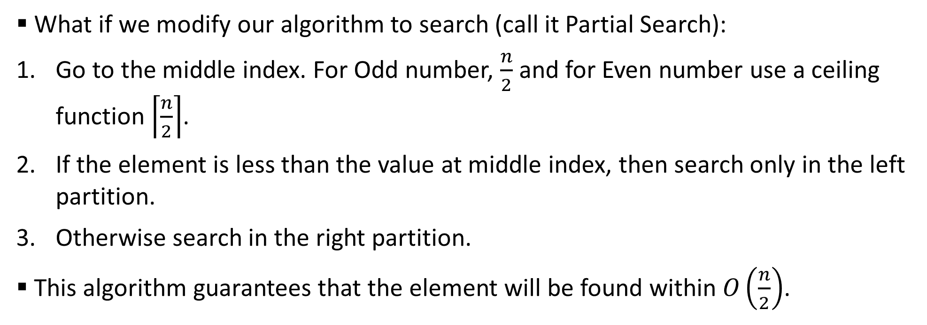
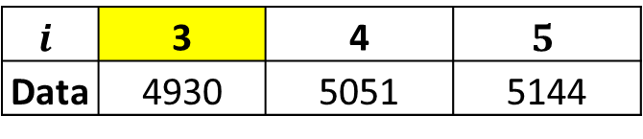
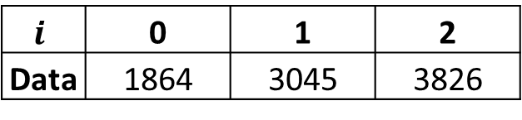
Sample 2
Binary Search
What if we modify our algorithm to search (call it Partial Search):
Go to the middle index. For Odd number, $\frac{n}{2}$ and for Even number use a ceiling function $\left\lceil \frac{n}{2}\right\rceil$.
If the element is less than the value at middle index, then search only in the left partition.
Otherwise search in the right partition.
This algorithm guarantees that the element will be found within $O\left(\frac{n}{2}\right)$.
$$i$$ | 0 | 1 | 2
Data | 1864 | 3045 | 3826
$$i$$ | 3 | 4 | $$5$$
Data | 4930 | 5051 | 5144

Slide 17
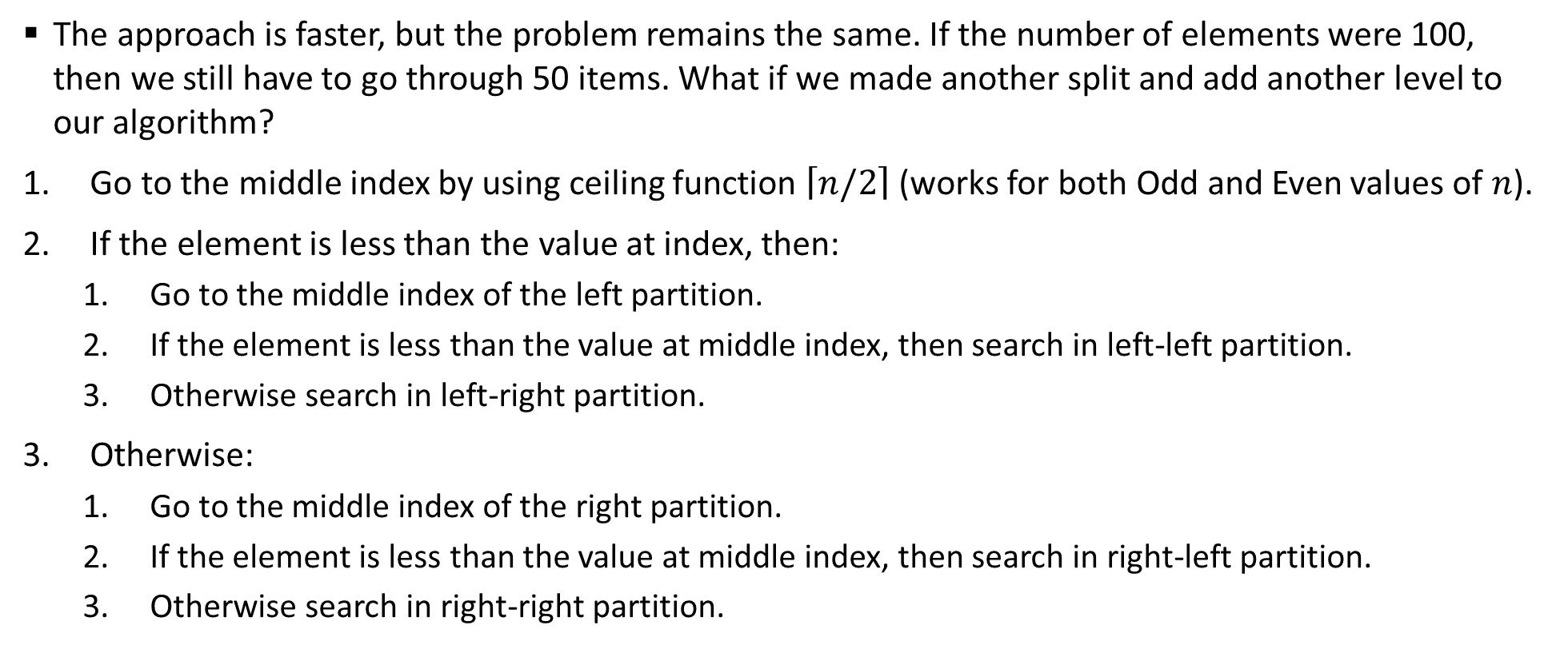
Sample 2
Binary Search
The approach is faster, but the problem remains the same. If the number of elements were 100, then we still have to go through 50 items. What if we made another split and add another level to our algorithm?
Go to the middle index by using ceiling function $\left\lceil n/2\right\rceil$ (works for both Odd and Even values of $n$).
If the element is less than the value at index, then:
Go to the middle index of the left partition.
If the element is less than the value at middle index, then search in left-left partition.
Otherwise search in left-right partition.
Otherwise:
Go to the middle index of the right partition.
If the element is less than the value at middle index, then search in right-left partition.
Otherwise search in right-right partition.

Slide 18
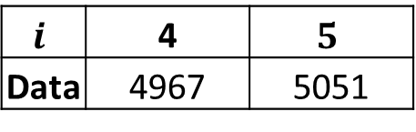
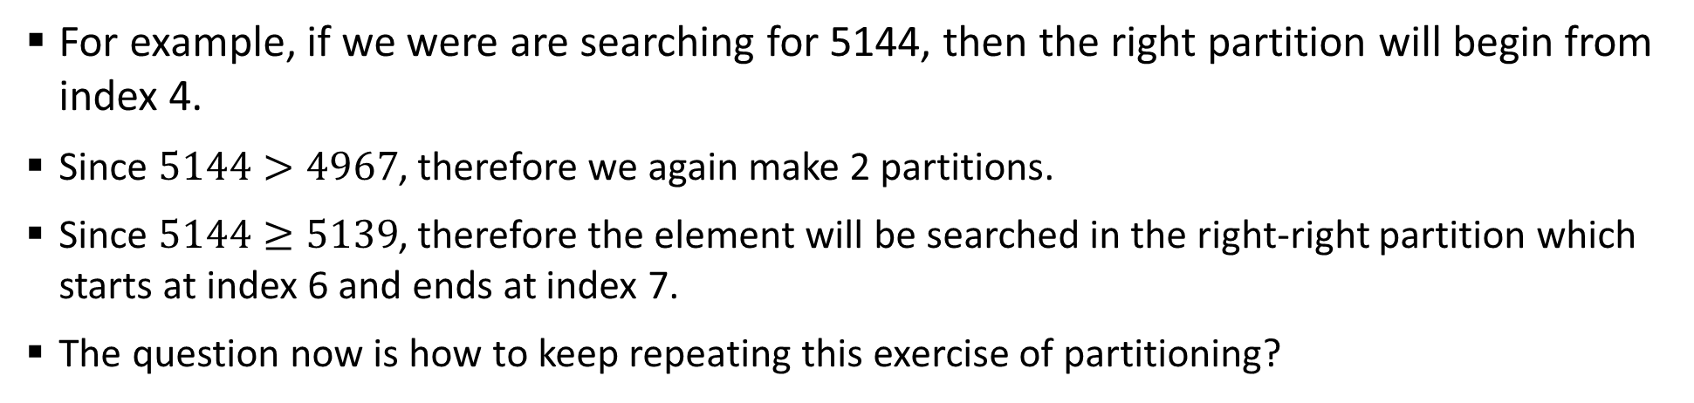
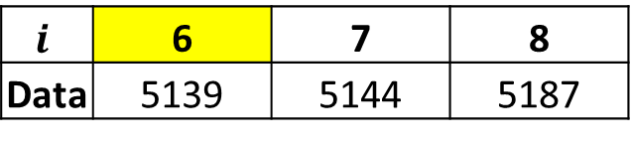
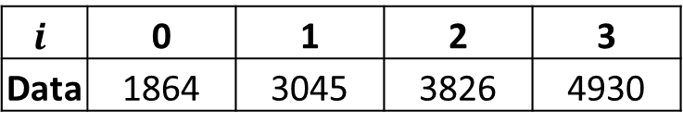
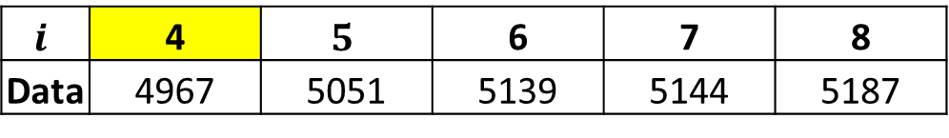
Sample 2
Binary Search
For example, if we were are searching for 5144, then the right partition will begin from index 4.
Since $5144>4967$, therefore we again make 2 partitions.
Since $5144≥5139$, therefore the element will be searched in the right-right partition which starts at index 6 and ends at index 7.
The question now is how to keep repeating this exercise of partitioning?
$$i$$ | 0 | 1 | 2 | 3 | 4 | $$5$$ | 6 | 7 | 8
Data | 1864 | 3045 | 3826 | 4930 | 4967 | 5051 | 5139 | 5144 | 5187
$$i$$ | 0 | 1 | 2 | 3
Data | 1864 | 3045 | 3826 | 4930
$$i$$ | 4 | $$5$$ | 6 | 7 | 8
Data | 4967 | 5051 | 5139 | 5144 | 5187
$$i$$ | 4 | $$5$$
Data | 4967 | 5051
$$i$$ | 6 | 7 | 8
Data | 5139 | 5144 | 5187

Slide 19
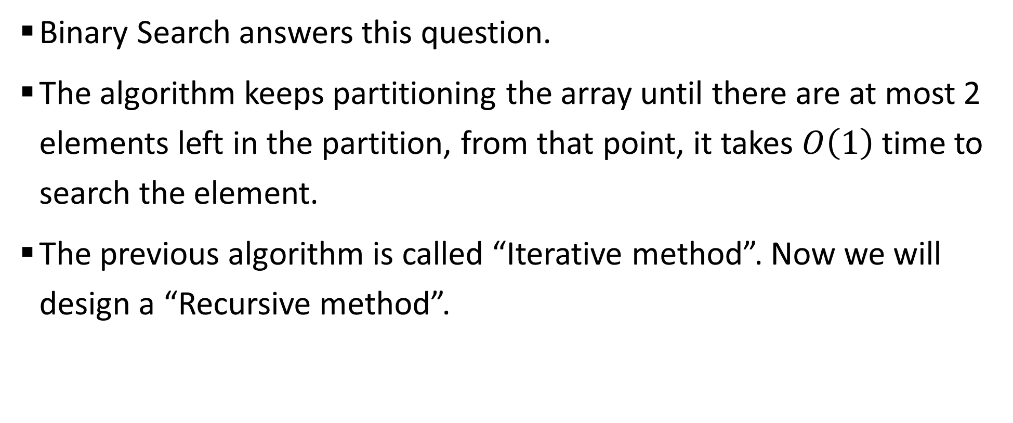
Sample 2
Binary Search
Binary Search answers this question.
The algorithm keeps partitioning the array until there are at most 2 elements left in the partition, from that point, it takes $O\left(1\right)$ time to search the element.
The previous algorithm is called “Iterative method”. Now we will design a “Recursive method”.

Slide 20
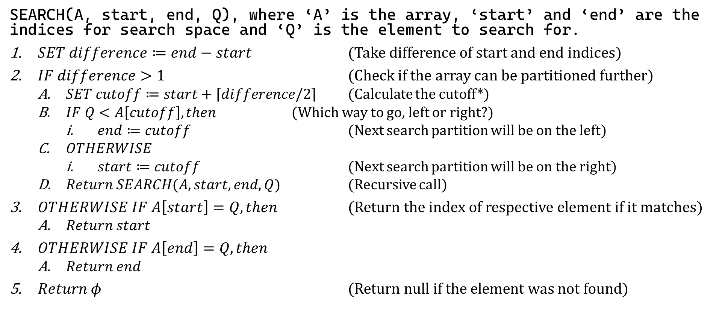
Sample 2
Binary Search – Algorithm
SEARCH(A, start, end, Q), where ‘A’ is the array, ‘start’ and ‘end’ are the indices for search space and ‘Q’ is the element to search for.
$SET difference≔end−start$ (Take difference of start and end indices)
$IF difference>1$ (Check if the array can be partitioned further)
$SET cutoff≔start+\left\lceil difference/2\right\rceil$ (Calculate the cutoff*)
$IF Q<A\left[cutoff\right], then$ (Which way to go, left or right?)
$end≔cutoff$ (Next search partition will be on the left)
$OTHERWISE$
$start≔cutoff$ (Next search partition will be on the right)
$Return SEARCH(A, start, end, Q)$ (Recursive call)
$OTHERWISE IF A\left[start\right]=Q, then$ (Return the index of respective element if it matches)
$Return start$
$OTHERWISE IF A\left[end\right]=Q, then$
$Return end$
$Return φ$ (Return null if the element was not found)
Notes:
The way we are calculating cutoff does not require checking for Even or Odd because we’re taking Ceiling of the quotient. Also note that we need to add “start” so that the indices are according to the Array.

Slide 21
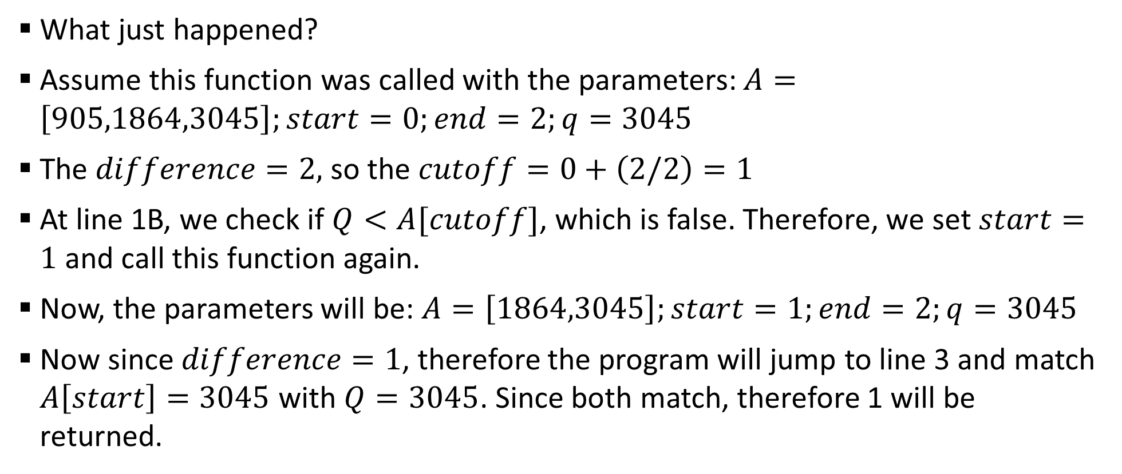
Sample 2
Binary Search
What just happened?
Assume this function was called with the parameters: $A=\left[905,1864,3045\right];start=0;end=2;q=3045$
The $difference=2,$ so the $cutoff=0+\left(2/2\right)=1$
At line 1B, we check if $Q<A[cutoff]$, which is false. Therefore, we set $start=1$ and call this function again.
Now, the parameters will be: $A=\left[1864,3045\right];start=1;end=2;q=3045$
Now since $difference=1$, therefore the program will jump to line 3 and match $A\left[start\right]=3045$ with $Q=3045$. Since both match, therefore 1 will be returned.

Slide 22
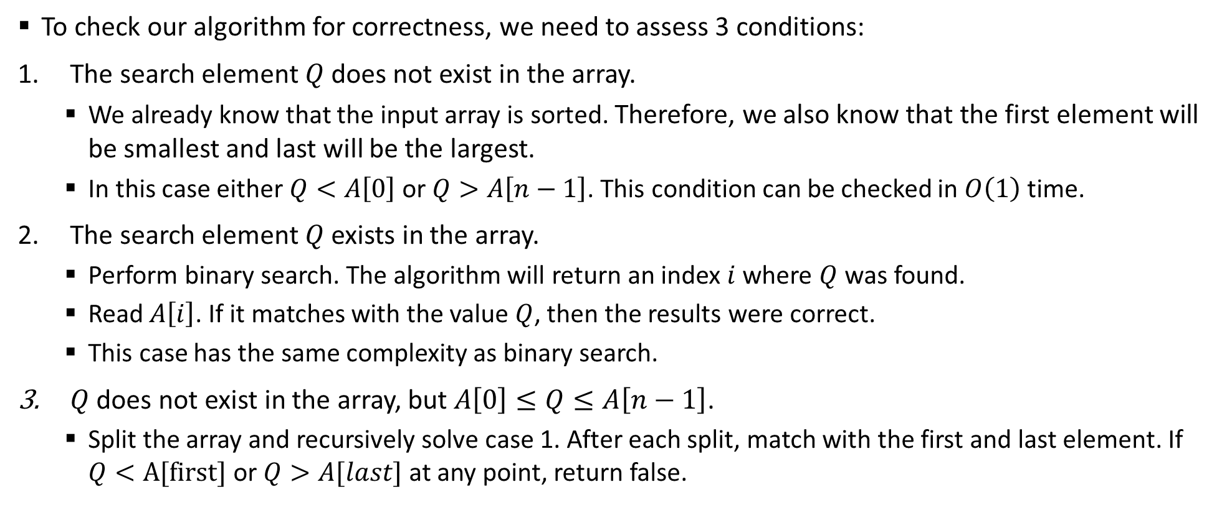
Sample 2
Binary Search – Correctness
To check our algorithm for correctness, we need to assess 3 conditions:
The search element $Q$ does not exist in the array.
We already know that the input array is sorted. Therefore, we also know that the first element will be smallest and last will be the largest.
In this case either $Q<A\left[0\right]$ or $Q>A\left[n−1\right]$. This condition can be checked in $O\left(1\right)$ time.
The search element $Q$ exists in the array.
Perform binary search. The algorithm will return an index $i$ where $Q$ was found.
Read $A\left[i\right]$. If it matches with the value $Q$, then the results were correct.
This case has the same complexity as binary search.
$Q$ does not exist in the array, but $A\left[0\right]≤Q≤A\left[n−1\right]$.
Split the array and recursively solve case 1. After each split, match with the first and last element. If $Q<A[first]$ or $Q>A[last]$ at any point, return false.

Slide 23
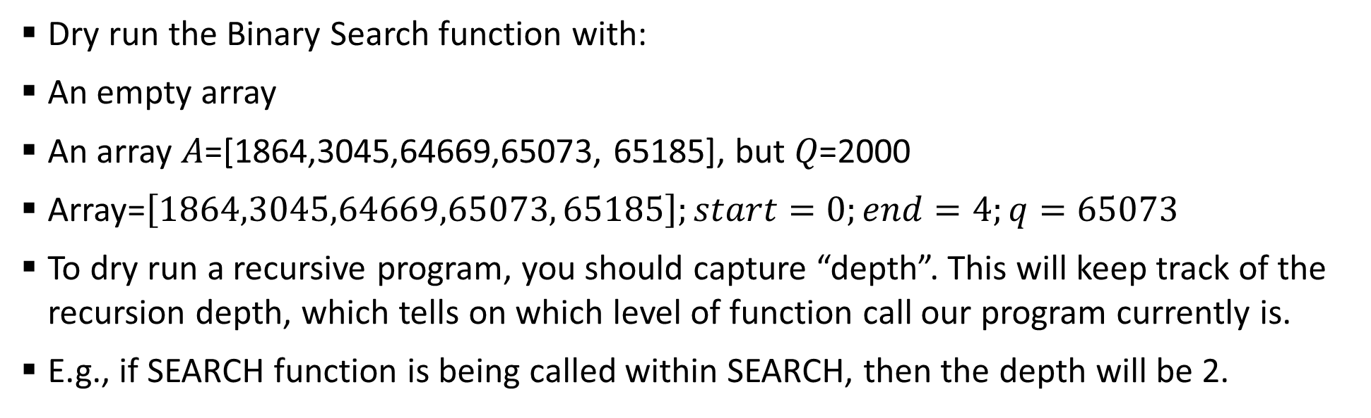
Sample 2
Exercise
Dry run the Binary Search function with:
An empty array
An array 𝐴=[1864,3045,64669,65073, 65185], but 𝑄=2000
Array=$\left[1864,3045,64669,65073, 65185\right];start=0;end=4;q=65073$
To dry run a recursive program, you should capture “depth”. This will keep track of the recursion depth, which tells on which level of function call our program currently is.
E.g., if SEARCH function is being called within SEARCH, then the depth will be 2.
Depth | Line No. | Array | Start | End | Q | Difference | Cutoff
1 | 0 | [1864,3045,64669,65073,65185]

Slide 24
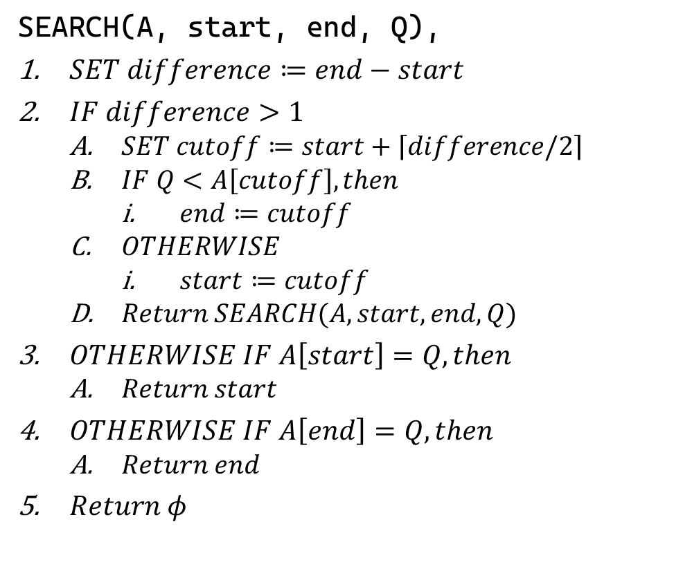
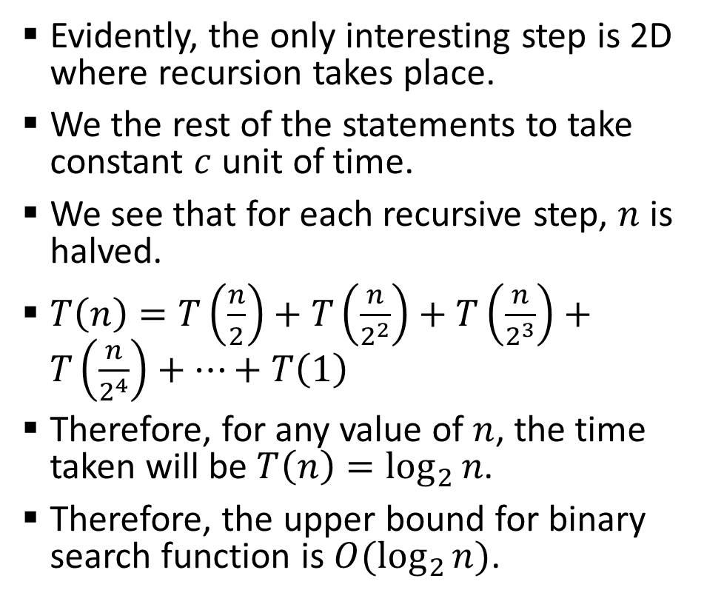
Sample 2
Complexity Analysis of Binary Search
Evidently, the only interesting step is 2D where recursion takes place.
We the rest of the statements to take constant $c$ unit of time.
We see that for each recursive step, $n$ is halved.
$T\left(n\right)=T\left(\frac{n}{2}\right)+T\left(\frac{n}{2^{2}}\right)+T\left(\frac{n}{2^{3}}\right)+T\left(\frac{n}{2^{4}}\right)+…+T\left(1\right)$
Therefore, for any value of $n$, the time taken will be $T\left(n\right)=\log_{2}{n}$.
Therefore, the upper bound for binary search function is $O(\log_{2}{n)}$.
SEARCH(A, start, end, Q),
$SET difference≔end−start$
$IF difference>1$
$SET cutoff≔start+\left\lceil difference/2\right\rceil$
$IF Q<A\left[cutoff\right], then$
$end≔cutoff$
$OTHERWISE$
$start≔cutoff$
$Return SEARCH(A, start, end, Q)$
$OTHERWISE IF A\left[start\right]=Q, then$
$Return start$
$OTHERWISE IF A\left[end\right]=Q, then$
$Return end$
$Return φ$
Notes:
In simple terms, $\log_{2}{n}$ asks how many times should $n$ be divided by 2 to reach the base case $T\left(1\right)$?

Slide 25
Sample 2
Tower of Hanoi Problem
The rules of this game are:
All cylinders must be moved from first post to the last.
Only one cylinder can be moved at a time.
A larger cylinder cannot be put over a smaller cylinder.
Cylinders can be moved back and forth any number of times.

Slide 26
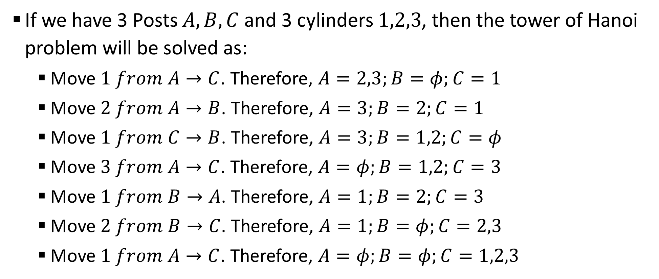
Sample 2
Tower of Hanoi Problem
If we have 3 Posts $A,B,C$ and 3 cylinders $1,2,3$, then the tower of Hanoi problem will be solved as:
Move $1 from A→C$. Therefore, $A=2,3;B=φ;C=1$
Move $2 from A→B$. Therefore, $A=3;B=2;C=1$
Move $1 from C→B$. Therefore, $A=3;B=1,2;C=φ$
Move $3 from A→C$. Therefore, $A=φ;B=1,2;C=3$
Move $1 from B→A$. Therefore, $A=1;B=2;C=3$
Move $2 from B→C$. Therefore, $A=1;B=φ;C=2,3$
Move $1 from A→C$. Therefore, $A=φ;B=φ;C=1,2,3$

Slide 27
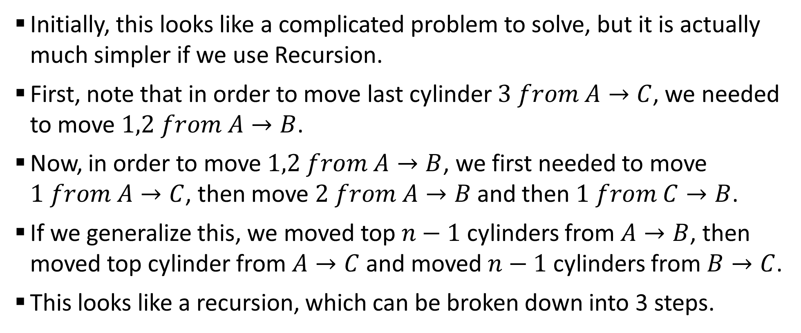
Sample 2
Tower of Hanoi Problem
Initially, this looks like a complicated problem to solve, but it is actually much simpler if we use Recursion.
First, note that in order to move last cylinder $3 from A→C$, we needed to move $1,2 from A→B$.
Now, in order to move $1,2 from A→B$, we first needed to move $1 from A→C$, then move $2 from A→B$ and then $1 from C→B$.
If we generalize this, we moved top $n−1$ cylinders from $A→B$, then moved top cylinder from $A→C$ and moved $n−1$ cylinders from $B→C$.
This looks like a recursion, which can be broken down into 3 steps.

Slide 28
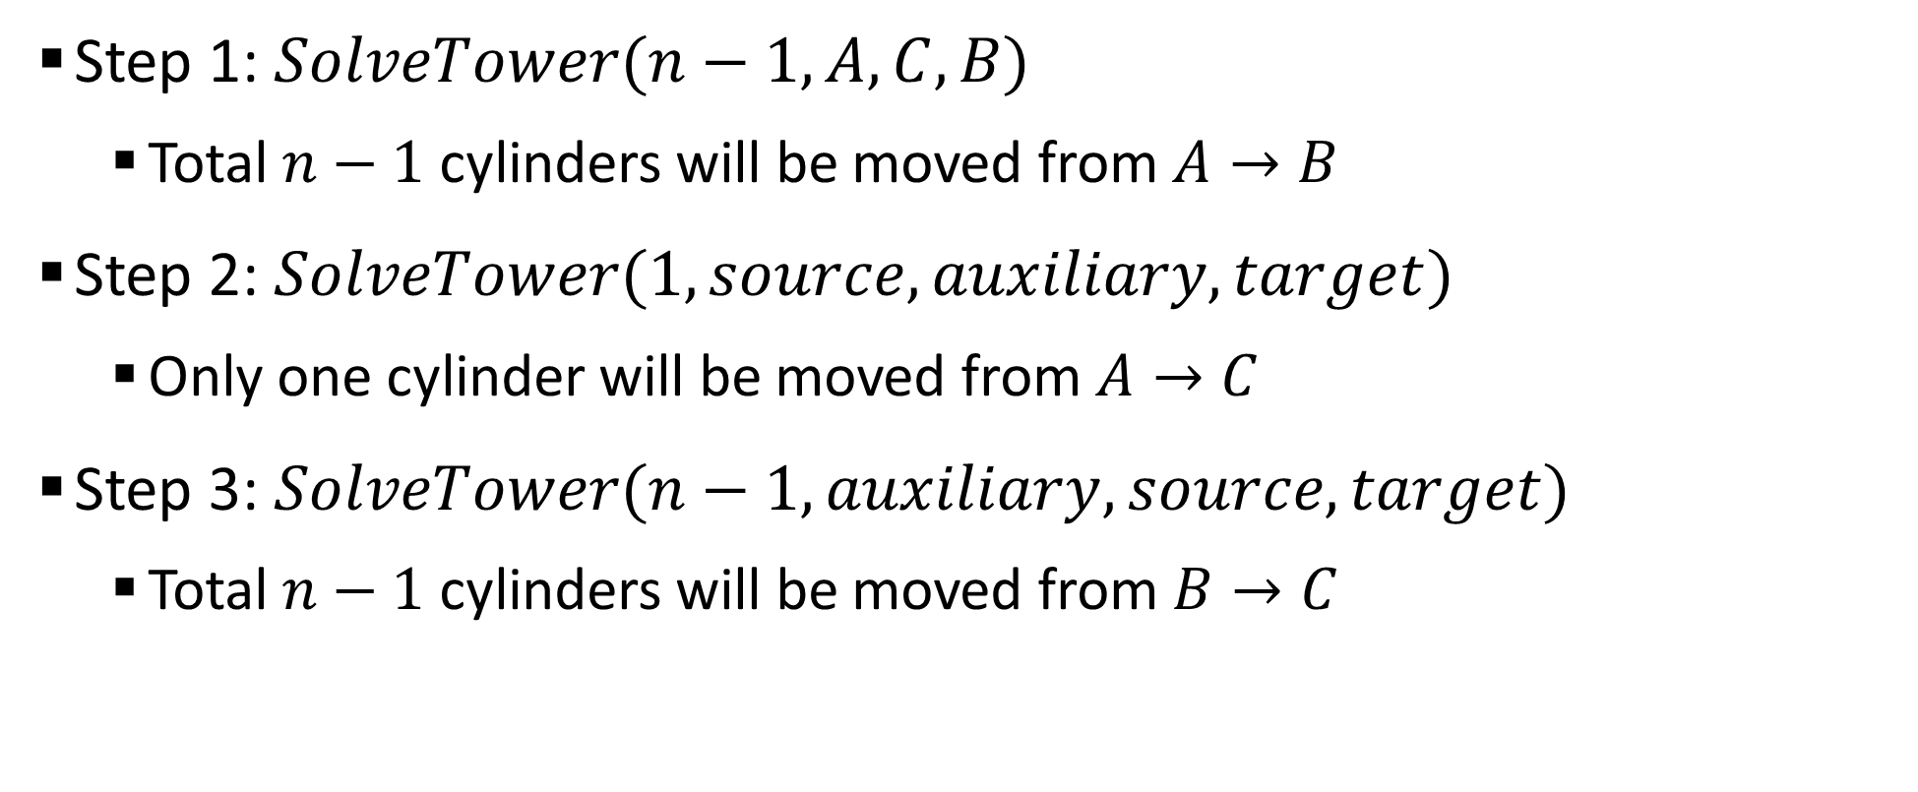
Sample 2
Tower of Hanoi Problem
Step 1: $SolveTower(n−1, A, C, B)$
Total $n−1$ cylinders will be moved from $A→B$
Step 2: $SolveTower(1, source,auxiliary, target)$
Only one cylinder will be moved from $A→C$
Step 3: $SolveTower(n−1, auxiliary,source, target)$
Total $n−1$ cylinders will be moved from $B→C$

Slide 29
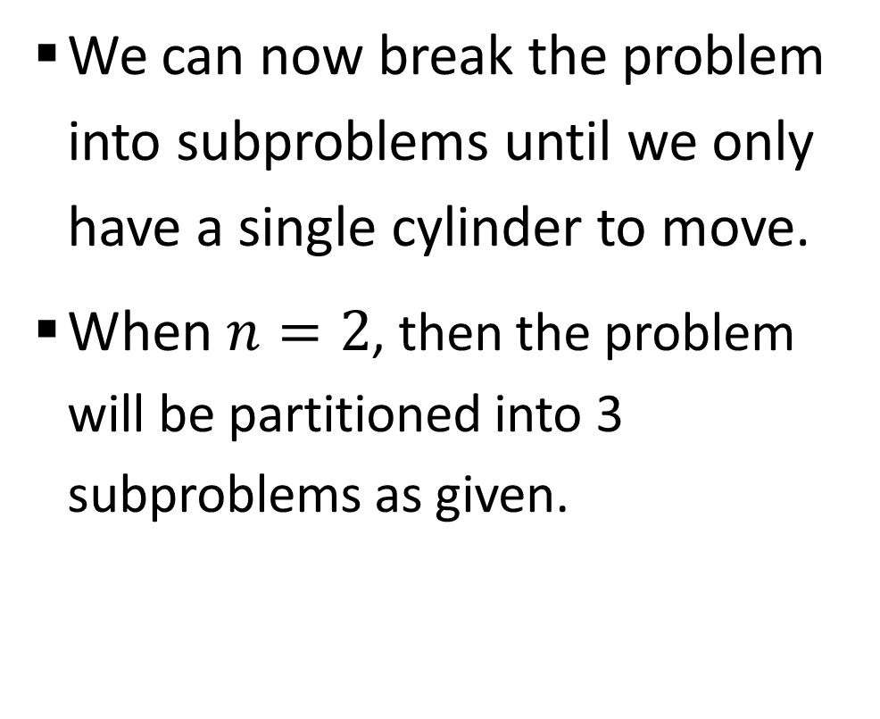
Sample 2
Tower of Hanoi Problem
We can now break the problem into subproblems until we only have a single cylinder to move.
When $n=2$, then the problem will be partitioned into 3 subproblems as given.
H(2)
A to B
A to C
B to C

Slide 30
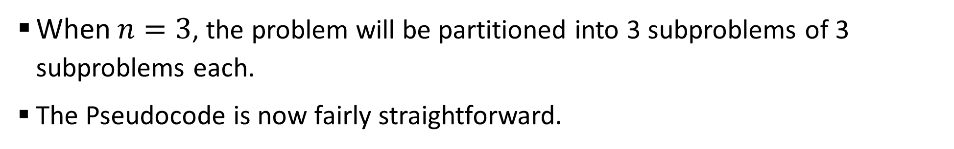
Sample 2
Tower of Hanoi Problem
When $n=3$, the problem will be partitioned into 3 subproblems of 3 subproblems each.
The Pseudocode is now fairly straightforward.
H(3)
H(2)
H(2)
H(2)
A to B
A to C
B to C
A to B
A to C
B to C
A to B
A to C
B to C

Slide 31
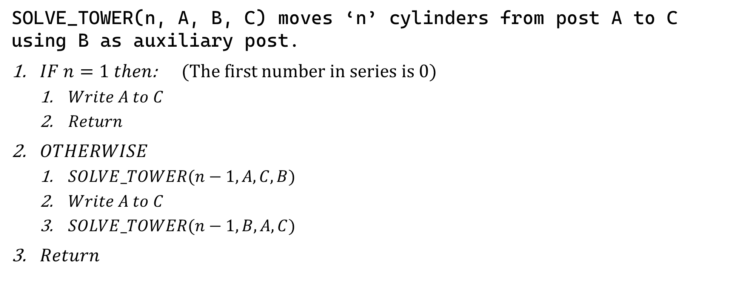
Sample 2
Tower of Hanoi Problem
SOLVE_TOWER(n, A, B, C) moves ‘n’ cylinders from post A to C using B as auxiliary post.
$IF n=1 then$: (The first number in series is 0)
$Write A to C$
$Return$
$OTHERWISE$
$SOLVE_TOWER(n−1,A,C,B)$
$Write A to C$
$SOLVE_TOWER(n−1,B,A,C)$
$Return$

Slide 32
Sample 2
Assignment 2a
You’ve learned about Fibonacci series and how it is reflected in the nature around us. In this assignment, you’ll observe how our own bodies follow the same phenomenon.
Your task is to measure the lengths of different organs and note them down in a series. Start with the mid finger. Measure the length from tip to the first joint, then measure from tip to second joint, then from tip to knuckle bone, then to the wrist, to elbow and all the way down to toes.
This series should be an approximate representation of Fibonacci numbers.
Calculate the average golden ratio for this series.

Slide 33
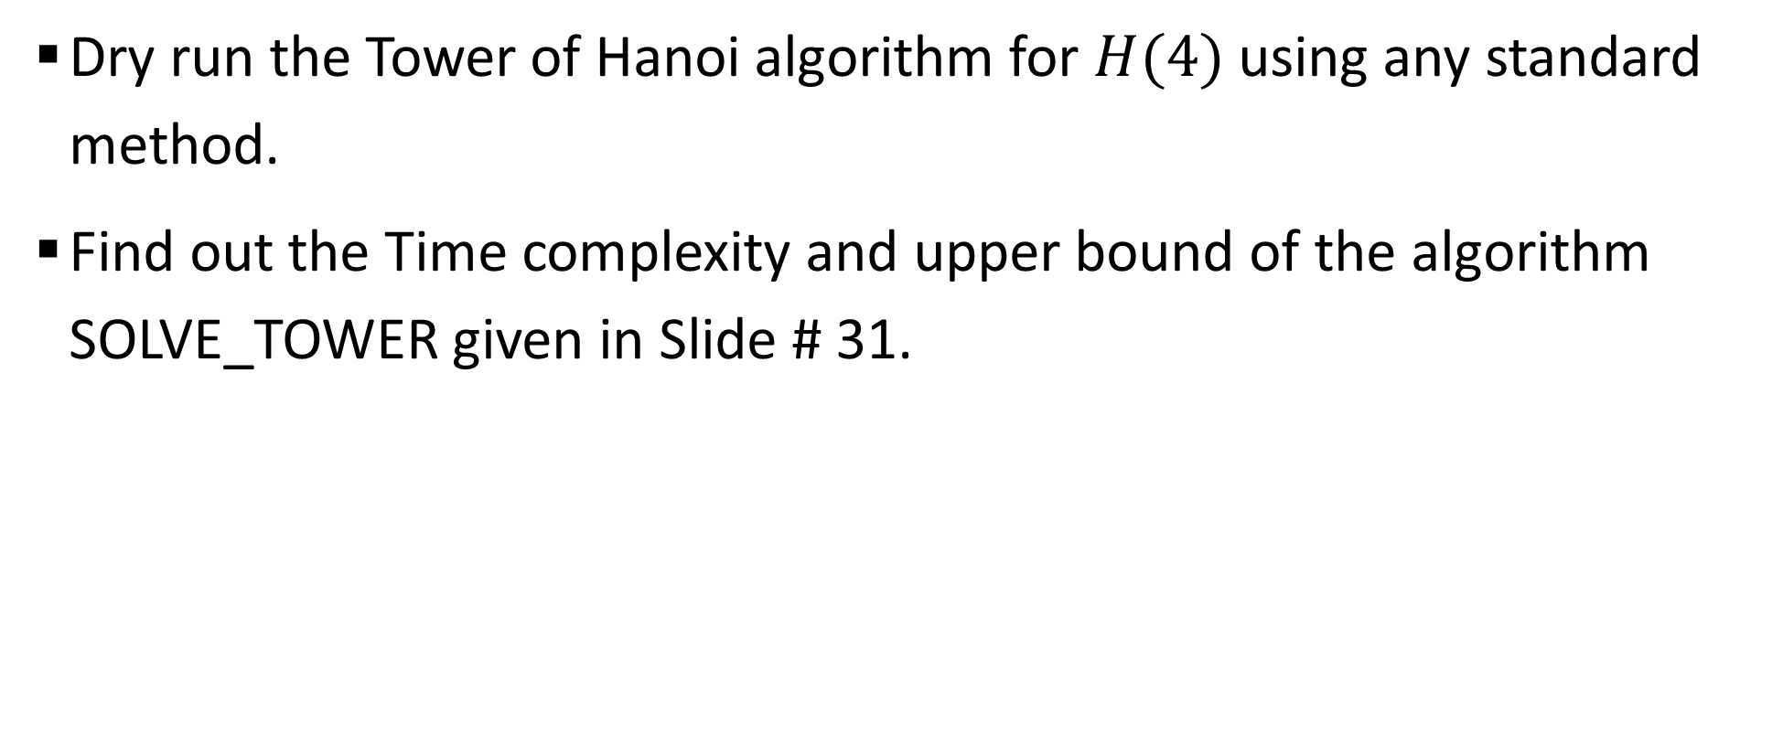
Sample 2
Assignment 2b
Dry run the Tower of Hanoi algorithm for $H(4)$ using any standard method.
Find out the Time complexity and upper bound of the algorithm SOLVE_TOWER given in Slide # 31.

Slide 34
Sample 2
Assignment 2b
H(1)
A-C
H(2)
H(1)
A-C
H(1)
A-B
B-C

Slide 35
Sample 2
Assignment 2b
H(3)
H(2)
A-C
H(2)
H(1)
A-B
H(1)
H(1)
B-C
H(1)
A-C
C-B
B-A
A-C
Note! When H3 calls H2 on left, it swaps B and C. Similarly, A and B are swapped on right side.

Slide 36
Sample 2
Assignment 2b
H(4)
H(3)
A-C
H(3)
H(2)
A-B
H(2)
H(2)
B-C
H(2)
H(1)
A-C
H(1)
H(1)
C-B
H(1)
H(1)
B-A
H(1)
H(1)
A-C
H(1)
A-B
B-C
C-A
A-B
B-C
C-A
B-C
A-B

Slide 37
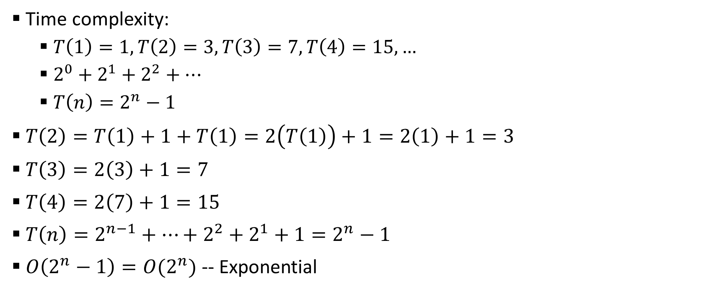
Sample 2
Assignment 2b
Time complexity:
$T\left(1\right)=1, T\left(2\right)=3, T\left(3\right)=7, T\left(4\right)=15,…$
$2^{0}+2^{1}+2^{2}+…$
$T\left(n\right)=2^{n}−1$
$T\left(2\right)=T\left(1\right)+1+T\left(1\right)=2\left(T\left(1\right)\right)+1=2\left(1\right)+1=3$
$T\left(3\right)=2\left(3\right)+1=7$
$T\left(4\right)=2\left(7\right)+1=15$
$T\left(n\right)=2^{n−1}+…+2^{2}+2^{1}+1=2^{n}−1$
$O\left(2^{n}−1\right)=O(2^{n})$ -- Exponential

Slide 38



THANK YOU
Owais Hussain
+92 345-3174270
owais.hussain@kiet.edu.pk
https://www.researchgate.net/profile/Owais-Hussain-3

